Slide 1
Advanced Bootstrap – Javascript
Developing a Mobile Ready UI using CSS3

Slide 2
What is jQuery
A freely available javascript library
http://www.jquery.com
Developer and release formats
Cross-browser compatibility functionality
Works almost everywhere (providing javascript is enabled)
Key features include
CSS3 selector patterns
Compatibility checking functions
jQuery UI
A plethora of plugins!
Notes:
Javascript is a notoriously tricky language often because of the different and non-standardised way that browsers process the scripting language. jQuery is a library built by a team that understand the way that browsers work, extracting us from many of the cross and legacy browser issues. jQuery allows us to write javascript once and benefit many times. Just in terms of dealing with the legacy event handling of IE6 vs. the rest of the world is a mammoth time saving functionality.
It has a series of key concepts we will be exploring during the course that include CSS3 type selectors. These selectors can be used in jQuery even for browsers that do not support CSS3.
We will explore the jQuery UI a sister project put together to provide rapid development of modern WEB2.0 style applications.
Plus we will explore the growing number of third party plugins and the principles of how to build your own.

Slide 3
Adding jQuery to a web page
jQuery is simply a javascript file
Add it to the HTML <head> element
There will be at least two versions of the file
jquery-2.x.x.js - The development version
jquery-2.x.x.min.js - The release version
The development file is uncompressed and commented
Easier for development
The release version is compressed
All whitespace removed
Much smaller for delivery
<script type="text/javascript" src="jquery-1.x.x.min.js"></script>
Notes:
Treat adding the jQuery library as you would adding any external javascript file. It is important to note that the jQuery reference must be added before you use any functionality from the library.
A standard download involves two files, an uncompressed and commented development version. This offers comments against each function and many development IDE pick up these comments and offer some sort of developer prompts.
The release version is compressed and has been minified with all whitespace and comments removed making it almost unreadable by human eyes.

Slide 4
The jQuery wrapper
jQuery uses selector notation
Similar to CSS
Makes it easier to pick up
In CSS we may define the selector
Meaning all anchors within a paragraph within a div
In jQuery we can select the same items using
Retrieves a JavaScript object containing an array of the DOM elements that match the selector
Lots of useful functions are attached to the object return from the call
$(selector); jQuery(selector);
div p a
$("div p a")
Notes:
As jQuery uses selector syntax it is relatively simple to select any DOM elements we would like. jQuery is by default aliased to $. One of the ways we can use this method call is by supplying the selector as a string as the parameter. The example above of “div p a” simply means all anchors that are within paragraphs that are within divisions of the page. When we retrieve the set we can apply many useful functions.

Slide 5
jQuery chaining
If we want to fade out all the div elements with class of finished
Special feature of jQuery sets
When a function (like fadeOut) is called
It returns the same set once is has completed
Allowing another operation to be executed
So we can chain the calls together
If using an id selector can treat as an array if we like
$("div.finished").fadeOut();
$("div.finished").fadeOut().addClass("gone");
$("#someElement").html("Some text"); $("#someElement")[0].innerHTML = "Some text";
Notes:
If we want to fade out all of the div elements with a class of finished we can use the line of code shown in the first example above.
One of the interesting and powerful features of jQuery is that when a function like fadeOut is called it will return the same set as the return type which means we can chain calls as in the second example.
The third example shows how we can use the return as an array if we like – the two code lines are equivalent but I’ll let you decide which is more readable.

Slide 6
Are you ready?
jQuery provides a ready() function which hooks into an event
jQuery code will execute as soon as is possible
This ensues a DOM object is there before you attempt to access it
Only needs to be run once per page
Should be used on most pages
The ready function()
$(document).ready(function() { alert('Are you ready?!'); });
The ready function() in short hand
$(function() { alert('Are you ready?!'); });
Notes:
Almost everything you do in jQuery will need to be done after the document is ready—so we’ll be using this action a lot. It will be referred to as the document-ready event from now on. Every example unless otherwise stated, needs to be run from inside the document-ready event. You should only need to declare it once per page though.

Slide 7
Bootstrap JavaScript Plugins
Bootstrap’s JavaScript plugins can be included all together, or as individuals.
All together now:
Or as a series of plugins:
<script src="js/bootstrap.min.js"></script>
<script src="js/popover.js"></script>
<script src="js/scrollspy.js"></script>

Slide 8
How Bootstrap Javascript Works
Bootstrap plugins can be used entirely through their data-* attributes
You only need to add certain classes or data attribute to the markup
The data- attribute is a global HTML5 attribute used for metadata
You can create your own terms for your application
E.G. data-qa-validate
Via javascript you can detect these attribute and react accordingly
Using javascript to add classes, events and other behaviour
It is an elegant solution but be careful of vocabulary collisions
If another library uses the same term you would have an issue

Slide 9
How Bootstrap Javascript Works
Bootstrap plugins can be used entirely through their JavaScript API
Built in the jQuery way, they return the collection acted upon and so are totally chainable
$('#myTabs a').click(function (e) {
e.preventDefault();
$(this).tab('show');
});
$(this).tab('show').addClass(‘activated’);

Slide 10
How Bootstrap Javascript Works
Bootstrap plugin’s accept three call patterns
Initialising the plugin with defaults
Initialising with an options object
Initialising with a string which immediately calls one of its methods.
$(‘#myElement’).tooltip() //default options
$(‘#myElement’).tooltip(‘show’) //method call
$(‘#myElement’).tooltip({ //override defaults
trigger: ‘click’,
animation: false
});

Slide 11

Tooltips
Provide users with contextual help
Add a data-toggle and a data-placement attribute and you’ve got a tooltip with CSS3 animations and not an image in sight!
For performance reasons tooltips break one of Bootstrap’s rules and need initialising in JavaScript:
<span data-toggle="tooltip" data-placement="bottom" title="PSEUDOPSEUDOHYPOPARATHYROIDISM">answer</span>
$(function () {
$('[data-toggle="tooltip"]').tooltip();
});
Notes:
Full list of Abide pre built patterns:

Slide 12
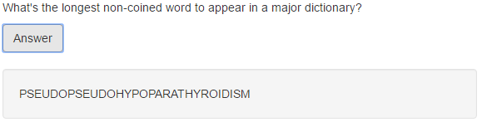

Collapse
A flexible plugin to easily create collapsible areas
<p>What's the longest non-coined word to appear in a major dictionary?</p>
<button class="btn btn-default" type="button" data-toggle="collapse" data-target="#answer">Answer</button>
<div class="collapse" id="answer">
<div class="well" id="answer">
PSEUDOPSEUDOHYPOPARATHYROIDISM
</div>
</div>
Notes:
Foundation provides the following named media queries. To use the named queries, just pass the name in where you would normally specify your query

Slide 13

Carousel
Carousel is a plugin that cycles through elements
Uses inbuilt HTML classes and structure
You only need to add the markup
<div id="qaCarousel" class="carousel slide" data-ride="carousel">
<div class="carousel-inner" role="listbox">
<div class="item active">
<img src="http://placehold.it/1280x350" alt="Placeholder image">
</div>
<div class="item">
...
</div>
</div>

Slide 14
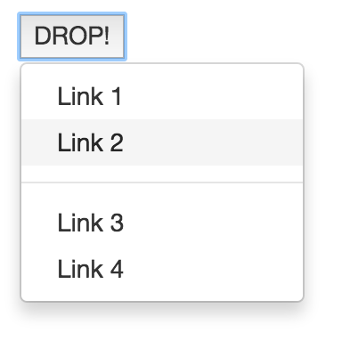
Dropdowns
The dropdown pattern can be added to almost anything, just follow the markup:
And they’re just super for use with navigation
<div class="dropdown" style="margin: 30px">
<button data-toggle="dropdown">
DROP!
<span class="carat"></span>
</button>
<ul class="dropdown-menu">
<li><a href="#">Link 1</a></li>
<li><a href="#">Link 2</a></li>
<li class="divider" role="seperator"></li>
<li><a href="#">Link 3</a></li>
<li><a href="#">Link 4</a></li>
</ul>
</div>

Slide 15
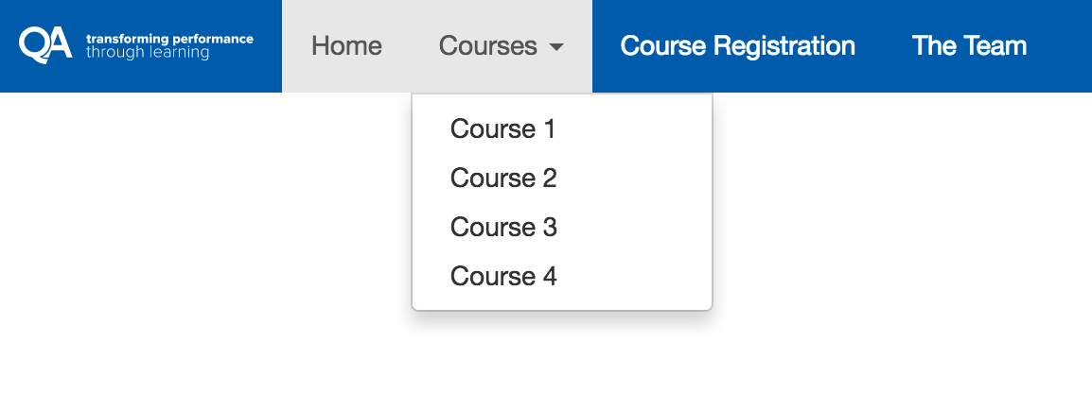
Dropdowns
And they’re just super for use with navigation

Slide 16
Exercise

